Slide 1
Bracketing

Slide 2
Bracketing
Identifying an interval containing a local minimum
and
then successively shrinking that interval

Slide 3
Unimodality
There exists a unique optimizer x* such that f is monotonically decreasing for x ≤ x* and monotonically increasing for x ≥ x*

Slide 4
Finding an Initial Bracket
Given a unimodal function, the global minimum is guaranteed to be inside the interval [a,c] if

Slide 5
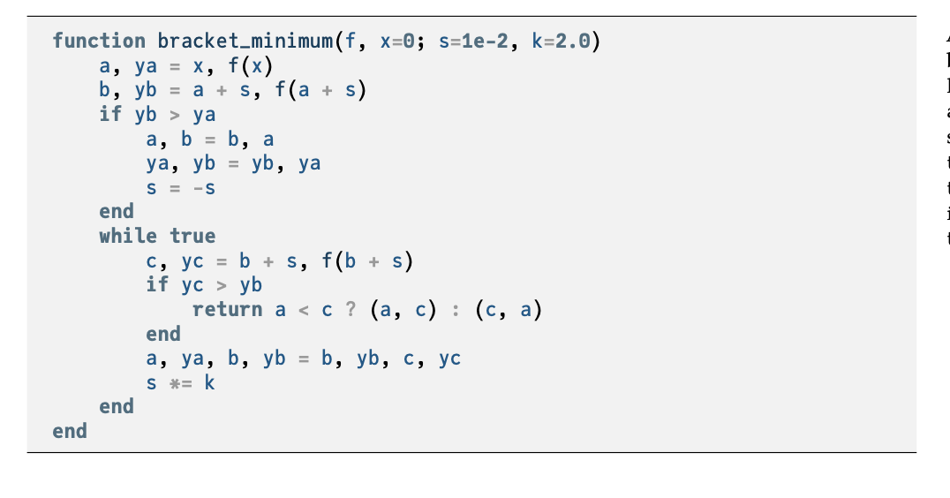


Slide 6
Finding an Initial Bracket
Example bracketing sequence

Slide 7
Fibonacci Search
When function evaluations are limited, the Fibonacci Search algorithm is guaranteed to maximally shrink the bracketed interval

Slide 8
Fibonacci Search
When restricted to two function evaluations, compare

Slide 9
Fibonacci Search
When restricted to three function evaluations

Slide 10
Fibonacci Search
When restricted to n function evaluations

Slide 11

Fibonacci Search
Binet’s formula defines a Fibonacci number analytically where φ is the Golden Ratio, φ=(1+$√5)/2≈1.61803$
The ratio between successive Fibonacci numbers is
where $s=\frac{1−\sqrt{5}}{1+\sqrt{5}}≈−0.382$

Slide 12
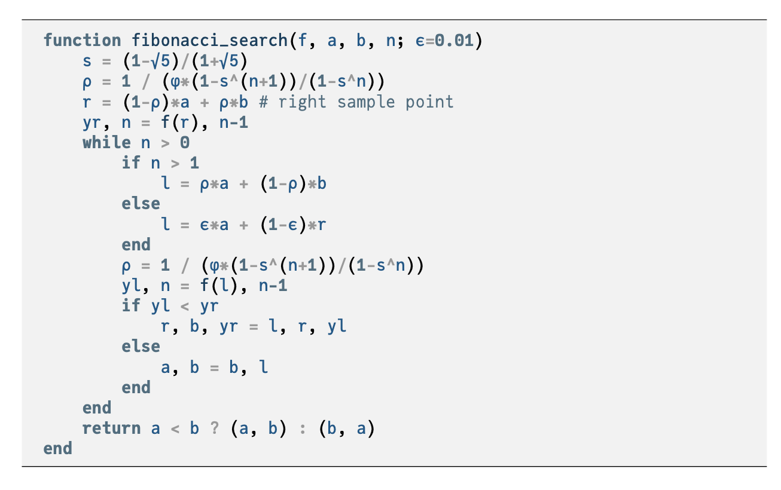

Slide 13
Quadratic Fit Search
Leverages ability to analytically minimize quadratic functions
Iteratively fits quadratic function to three bracketing points

Slide 14
Quadratic Fit Search
If a function is locally nearly quadratic, the minimum can be found after several steps

Slide 15
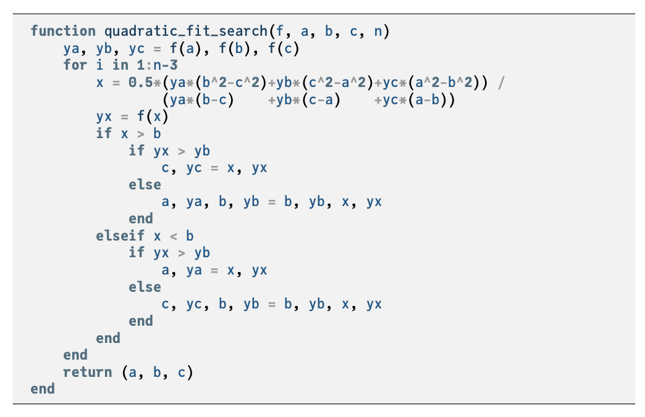

Slide 16
Summary
Many optimization methods shrink a bracketing interval, including Fibonacci search, golden section search, and quadratic fit search

